Slide 1
CPSC331 - Spring 2019 Tutorial 04
Khobaib Zaamout

Slide 2
Question 1: Prove loop invariant
Q1) Prove that the following is a loop invariant for the loop in this algorithm:
integer betterFibLoop (integer n) {
1. if (n == 0) {
2. return 0
} else {
3. integer oldest := 0
4. integer middle := 1
5. integer i := 1
6. while (i < n) {
7. integer youngest := oldest + middle
8. oldest := middle
9. middle := youngest
10. i := i + 1
}
11. return middle
}
}
Loop Invariant (A):
1. n is an integer input such that n≥1.
2. i is an integer variable such that 1 ≤ I ≤ n.
3. oldest is an integer variable with value F_{i−1}.
4. middle is an integer variable with value F_{i}.

Slide 3
Question 1: Prove loop invariant
Work Area:
Background: by loop theorem #1 A is a loop invariant if:
an execution of the loop test t does not change the value of any inputs, variables, or global data,
A is satisfied whenever the loop is reached, during an execution of the algorithm starting with the problem’s precondition being satisfied, and
if A is satisfied at the beginning of any execution of the loop body S then A is satisfied, once again, when this execution of the loop body ends.

Slide 4

Question 1: Prove loop invariant
Work Area:
Background: by loop theorem #1 A is a loop invariant if:
From the code, the loop test at line 6 has no side-effects.
$∴$ This is property holds.
an execution of the loop test t does not change the value of any inputs, variables, or global data,
A is satisfied whenever the loop is reached, during an execution of the algorithm starting with the problem’s precondition being satisfied, and
if A is satisfied at the beginning of any execution of the loop body S then A is satisfied, once again, when this execution of the loop body ends.

Slide 5
Question 1: Prove loop invariant
Work Area:
Background: by loop theorem #1 A is a loop invariant if:
an execution of the loop test t does not change the value of any inputs, variables, or global data,
A is satisfied whenever the loop is reached, during an execution of the algorithm starting with the problem’s precondition being satisfied, and
if A is satisfied at the beginning of any execution of the loop body S then A is satisfied, once again, when this execution of the loop body ends.

Slide 6
Question 1: Prove loop invariant
Work Area:
Background: by loop theorem #1 A is a loop invariant if:
NOTE: it is clear from the code that the loop can never be executed a second time, so it suffices to consider a first execution of this loop.
an execution of the loop test t does not change the value of any inputs, variables, or global data,
A is satisfied whenever the loop is reached, during an execution of the algorithm starting with the problem’s precondition being satisfied, and
if A is satisfied at the beginning of any execution of the loop body S then A is satisfied, once again, when this execution of the loop body ends.

Slide 7
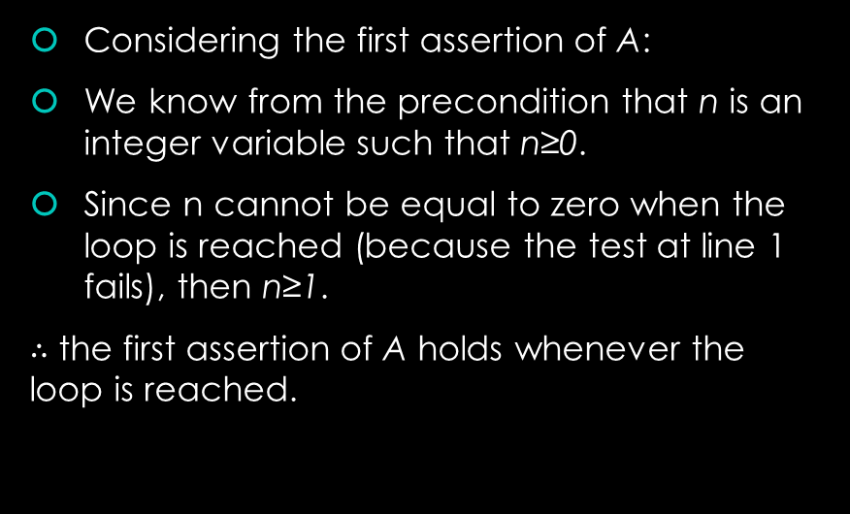
Question 1: Prove loop invariant
Work Area:
Background: by loop theorem #1 A is a loop invariant if:
Considering the first assertion of A:
We know from the precondition that n is an integer variable such that n≥0.
Since n cannot be equal to zero when the loop is reached (because the test at line 1 fails), then n≥1.
$∴$ the first assertion of A holds whenever the loop is reached.
an execution of the loop test t does not change the value of any inputs, variables, or global data,
A is satisfied whenever the loop is reached, during an execution of the algorithm starting with the problem’s precondition being satisfied, and
if A is satisfied at the beginning of any execution of the loop body S then A is satisfied, once again, when this execution of the loop body ends.

Slide 8
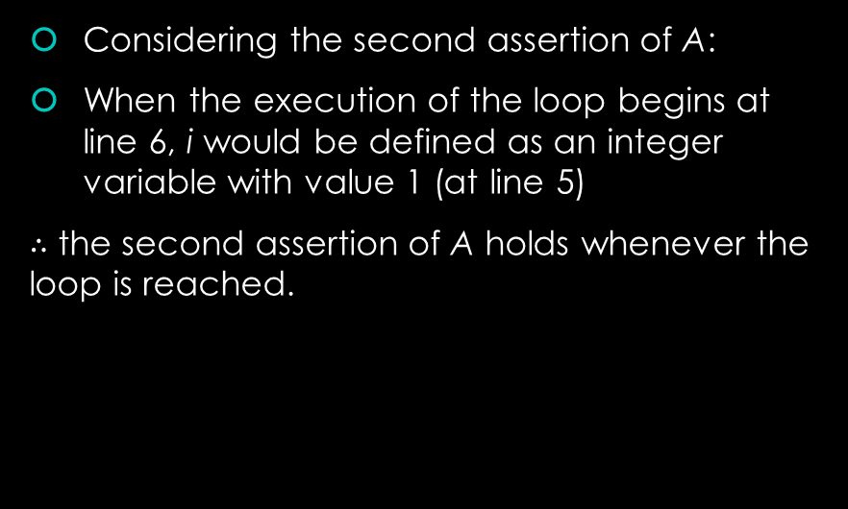
Question 1: Prove loop invariant
Work Area:
Background: by loop theorem #1 A is a loop invariant if:
Considering the second assertion of A:
When the execution of the loop begins at line 6, i would be defined as an integer variable with value 1 (at line 5)
$∴$ the second assertion of A holds whenever the loop is reached.
an execution of the loop test t does not change the value of any inputs, variables, or global data,
A is satisfied whenever the loop is reached, during an execution of the algorithm starting with the problem’s precondition being satisfied, and
if A is satisfied at the beginning of any execution of the loop body S then A is satisfied, once again, when this execution of the loop body ends.

Slide 9
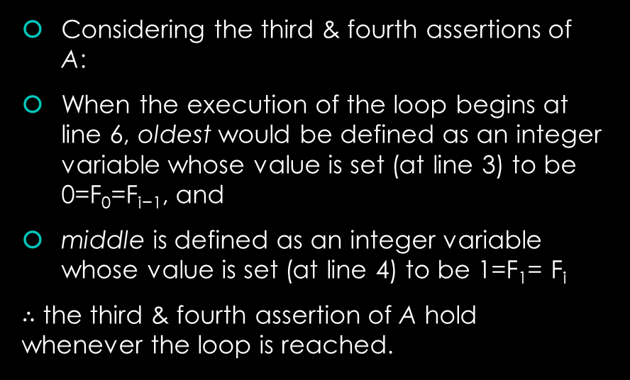
Question 1: Prove loop invariant
Work Area:
Background: by loop theorem #1 A is a loop invariant if:
Considering the third & fourth assertions of A:
When the execution of the loop begins at line 6, oldest would be defined as an integer variable whose value is set (at line 3) to be 0=F₀=F_{i−1}, and
middle is defined as an integer variable whose value is set (at line 4) to be 1=F₁= F_{i}
$∴$ the third & fourth assertion of A hold whenever the loop is reached.
an execution of the loop test t does not change the value of any inputs, variables, or global data,
A is satisfied whenever the loop is reached, during an execution of the algorithm starting with the problem’s precondition being satisfied, and
if A is satisfied at the beginning of any execution of the loop body S then A is satisfied, once again, when this execution of the loop body ends.

Slide 10
Question 1: Prove loop invariant
Work Area:
Background: by loop theorem #1 A is a loop invariant if:
Since A’s assertions hold whenever the loop is reached, then it follows that:
A holds whenever the loop is reached.
an execution of the loop test t does not change the value of any inputs, variables, or global data,
A is satisfied whenever the loop is reached, during an execution of the algorithm starting with the problem’s precondition being satisfied, and
if A is satisfied at the beginning of any execution of the loop body S then A is satisfied, once again, when this execution of the loop body ends.

Slide 11
Question 1: Prove loop invariant
Work Area:
Background: by loop theorem #1 A is a loop invariant if:
an execution of the loop test t does not change the value of any inputs, variables, or global data,
A is satisfied whenever the loop is reached, during an execution of the algorithm starting with the problem’s precondition being satisfied, and
if A is satisfied at the beginning of any execution of the loop body S then A is satisfied, once again, when this execution of the loop body ends.

Slide 12
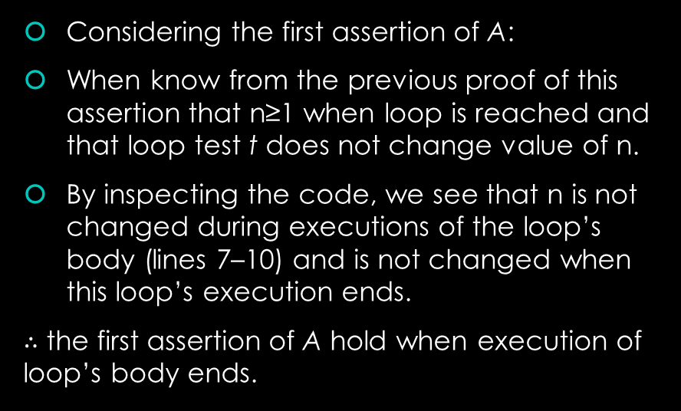
Question 1: Prove loop invariant
Work Area:
Background: by loop theorem #1 A is a loop invariant if:
Considering the first assertion of A:
When know from the previous proof of this assertion that n≥1 when loop is reached and that loop test t does not change value of n.
By inspecting the code, we see that n is not changed during executions of the loop’s body (lines 7–10) and is not changed when this loop’s execution ends.
$∴$ the first assertion of A hold when execution of loop’s body ends.
an execution of the loop test t does not change the value of any inputs, variables, or global data,
A is satisfied whenever the loop is reached, during an execution of the algorithm starting with the problem’s precondition being satisfied, and
if A is satisfied at the beginning of any execution of the loop body S then A is satisfied, once again, when this execution of the loop body ends.

Slide 13
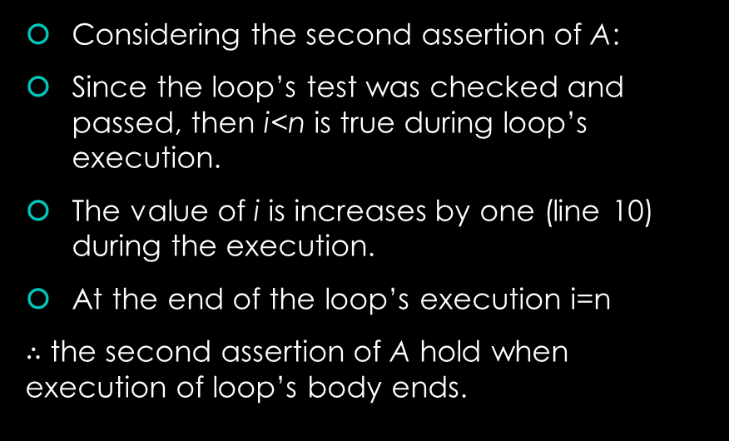
Question 1: Prove loop invariant
Work Area:
Background: by loop theorem #1 A is a loop invariant if:
Considering the second assertion of A:
Since the loop’s test was checked and passed, then i<n is true during loop’s execution.
The value of i is increases by one (line 10) during the execution.
At the end of the loop’s execution i=n
$∴$ the second assertion of A hold when execution of loop’s body ends.
an execution of the loop test t does not change the value of any inputs, variables, or global data,
A is satisfied whenever the loop is reached, during an execution of the algorithm starting with the problem’s precondition being satisfied, and
if A is satisfied at the beginning of any execution of the loop body S then A is satisfied, once again, when this execution of the loop body ends.

Slide 14
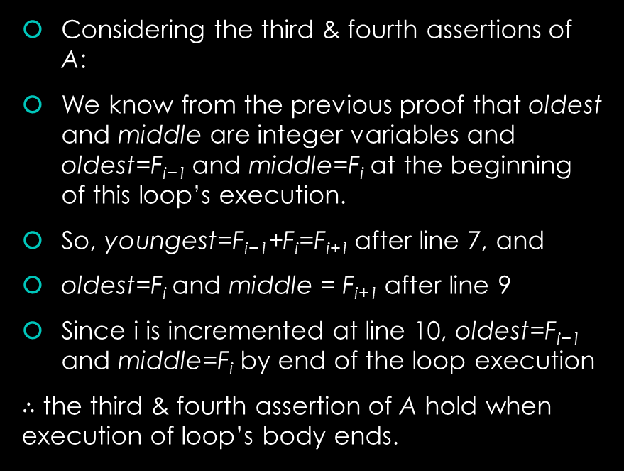
Question 1: Prove loop invariant
Work Area:
Background: by loop theorem #1 A is a loop invariant if:
Considering the third & fourth assertions of A:
We know from the previous proof that oldest and middle are integer variables and oldest=F_{i−1} and middle=F_{i} at the beginning of this loop’s execution.
So, youngest=F_{i−1}+F_{i}=F_{i+1} after line 7, and
oldest=F_{i} and middle = F_{i+1} after line 9
Since i is incremented at line 10, oldest=F_{i−1} and middle=F_{i} by end of the loop execution
$∴$ the third & fourth assertion of A hold when execution of loop’s body ends.
an execution of the loop test t does not change the value of any inputs, variables, or global data,
A is satisfied whenever the loop is reached, during an execution of the algorithm starting with the problem’s precondition being satisfied, and
if A is satisfied at the beginning of any execution of the loop body S then A is satisfied, once again, when this execution of the loop body ends.

Slide 15
Question 1: Prove loop invariant
Work Area:
Background: by loop theorem #1 A is a loop invariant if:
Since A’s assertions hold when execution of loop’s body ends, then it follows that:
A holds when execution of loop’s body ends.
Since A holds at each of the three positions of this algorithm’s loop, then it follows by “Loop Theorem #1” that this is a loop invariant for this loop.
an execution of the loop test t does not change the value of any inputs, variables, or global data,
A is satisfied whenever the loop is reached, during an execution of the algorithm starting with the problem’s precondition being satisfied, and
if A is satisfied at the beginning of any execution of the loop body S then A is satisfied, once again, when this execution of the loop body ends.

Slide 16
Question 2: Prove partially correct
Q2) Use this to prove that the betterFibLoop is partially correct

Slide 17
Question 2: Prove partially correct
Work Area:
Background: An algorithm is partially correct if one of the properties holds:
this execution of the algorithm eventually ends with the problem’s postcondition satisfied — and with no undocumented inputs or global data accessed, and no undocumented data being modified, or
this execution of the algorithm never ends, at all.

Slide 18
Question 2: Prove partially correct
Work Area:
Background: An algorithm is partially correct if one of the properties holds:
Note: by inspecting the algorithm’s signature and code, it is clear that it has no undocumented side-effects.
this execution of the algorithm eventually ends with the problem’s postcondition satisfied — and with no undocumented inputs or global data accessed, and no undocumented data being modified, or
this execution of the algorithm never ends, at all.

Slide 19
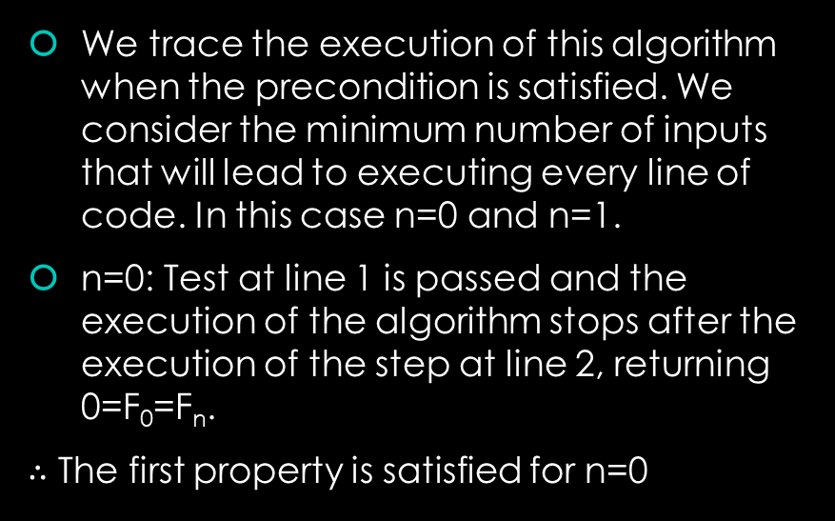
Question 2: Prove partially correct
Work Area:
Background: An algorithm is partially correct if one of the properties holds:
We trace the execution of this algorithm when the precondition is satisfied. We consider the minimum number of inputs that will lead to executing every line of code. In this case n=0 and n=1.
n=0: Test at line 1 is passed and the execution of the algorithm stops after the execution of the step at line 2, returning 0=F₀=F_{n}.
$∴$ The first property is satisfied for n=0
this execution of the algorithm eventually ends with the problem’s postcondition satisfied — and with no undocumented inputs or global data accessed, and no undocumented data being modified, or
this execution of the algorithm never ends, at all.

Slide 20
Question 2: Prove partially correct
Work Area:
Background: An algorithm is partially correct if one of the properties holds:
n=1: The test at line 1 fails, the steps at line 3–5 are executed, and the while loop is reached and executed after that.
If the execution of the loop never ends then the execution of the algorithm never ends and the second property is satisfied.
If the execution of the loop ends then we show that postcondition is satisfied:
… next slide
this execution of the algorithm eventually ends with the problem’s postcondition satisfied — and with no undocumented inputs or global data accessed, and no undocumented data being modified, or
this execution of the algorithm never ends, at all.

Slide 21
Question 2: Prove partially correct
Work Area:
Background: An algorithm is partially correct if one of the properties holds:
…show that postcondition is satisfied:
By the loop invariant’s assertions 1 & 2, i is an integer variable and n is an integer input such that 1 ≤ i ≤ n.
Since the loop test failed in order for the execution of the loop to end, then i ≥ n. So, i = n at the end of the execution of the while loop.
It follows by loop invariant’s 4th assertion that middle=F_{i}=F_{n}.
this execution of the algorithm eventually ends with the problem’s postcondition satisfied — and with no undocumented inputs or global data accessed, and no undocumented data being modified, or
this execution of the algorithm never ends, at all.

Slide 22
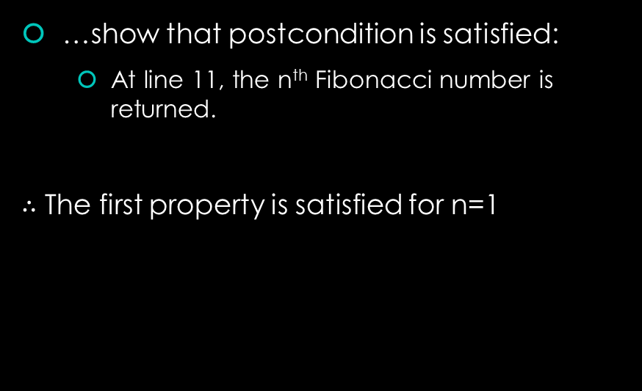
Question 2: Prove partially correct
Work Area:
Background: An algorithm is partially correct if one of the properties holds:
…show that postcondition is satisfied:
At line 11, the n^{th} Fibonacci number is returned.
$∴$ The first property is satisfied for n=1
this execution of the algorithm eventually ends with the problem’s postcondition satisfied — and with no undocumented inputs or global data accessed, and no undocumented data being modified, or
this execution of the algorithm never ends, at all.

Slide 23
Question 2: Prove partially correct
Work Area:
Background: An algorithm is partially correct if one of the properties holds:
We showed that the first property holds in every possible case.
By the definition of partially correct algorithms, it follows that this algorithm is partially correct, as claimed.
this execution of the algorithm eventually ends with the problem’s postcondition satisfied — and with no undocumented inputs or global data accessed, and no undocumented data being modified, or
this execution of the algorithm never ends, at all.

Slide 24
Question 3: Give & prove bound function
Give a bound function for the while loop in this algorithm, and show that your answer is correct

Slide 25
Question 3: Give & prove bound function
Work Area:
Background: A bound function for a while loop is:
an integer-valued, total function of some of the inputs, variables and global data that are defined when the loop is reached.
When the loop body is executed, the value of this function is decreased by at least one before the loop’s test is checked again, if at all.
If the value of this function is ≤ 0 and the loop’s test is checked then the test fails (ending this execution of the loop).

Slide 26
Question 3: Give & prove bound function
Work Area:
Background: A bound function for a while loop is:
We give f(n, i) = n − i as the bound function for the while loop in this algorithm and prove it as follows:
Since n is an integer input, and i is an integer variable whose value is defined before the while loop is reached then this is certainly a well-defined total function of the inputs and local variables of this algorithm.
an integer-valued, total function of some of the inputs, variables and global data that are defined when the loop is reached.
When the loop body is executed, the value of this function is decreased by at least one before the loop’s test is checked again, if at all.
If the value of this function is ≤ 0 and the loop’s test is checked then the test fails (ending this execution of the loop).

Slide 27
Question 3: Give & prove bound function
Work Area:
Background: A bound function for a while loop is:
an integer-valued, total function of some of the inputs, variables and global data that are defined when the loop is reached.
When the loop body is executed, the value of this function is decreased by at least one before the loop’s test is checked again, if at all.
If the value of this function is ≤ 0 and the loop’s test is checked then the test fails (ending this execution of the loop).

Slide 28
Question 3: Give & prove bound function
Work Area:
Background: A bound function for a while loop is:
The value of n is not changed during loop execution
The value of i is increased by one, as a result of the execution of the step at line 10.
Thus the function’s value f is decreased by (at least) one whenever the body of the while loop is executed.
an integer-valued, total function of some of the inputs, variables and global data that are defined when the loop is reached.
When the loop body is executed, the value of this function is decreased by at least one before the loop’s test is checked again, if at all.
If the value of this function is ≤ 0 and the loop’s test is checked then the test fails (ending this execution of the loop).

Slide 29
Question 3: Give & prove bound function
Work Area:
Background: A bound function for a while loop is:
an integer-valued, total function of some of the inputs, variables and global data that are defined when the loop is reached.
When the loop body is executed, the value of this function is decreased by at least one before the loop’s test is checked again, if at all.
If the value of this function is ≤ 0 and the loop’s test is checked then the test fails (ending this execution of the loop).

Slide 30
Question 3: Give & prove bound function
Work Area:
Background: A bound function for a while loop is:
Suppose that the value of this function is less than or equal to zero, that is, n−i ≤ 0. Then i ≥ n and the loop test at line 6 fails, causing the execution of the loop to stop.
Thus, f(n,i)=n-i is a bound function for the while loop in this algorithm, because it satisfies all the properties.
an integer-valued, total function of some of the inputs, variables and global data that are defined when the loop is reached.
When the loop body is executed, the value of this function is decreased by at least one before the loop’s test is checked again, if at all.
If the value of this function is ≤ 0 and the loop’s test is checked then the test fails (ending this execution of the loop).

